Slide 1
Habitat for Humanity
Winter Break 2011

Slide 2
Winter Break Logistics
Taking 15 people (includes 1 adviser and site leader)
Depart: Sunday, January 9th, 2011
Return: Saturday, January 15th, 2011
Location……..

Slide 3
SAN DIEGO, CALIFORNIA

Slide 4
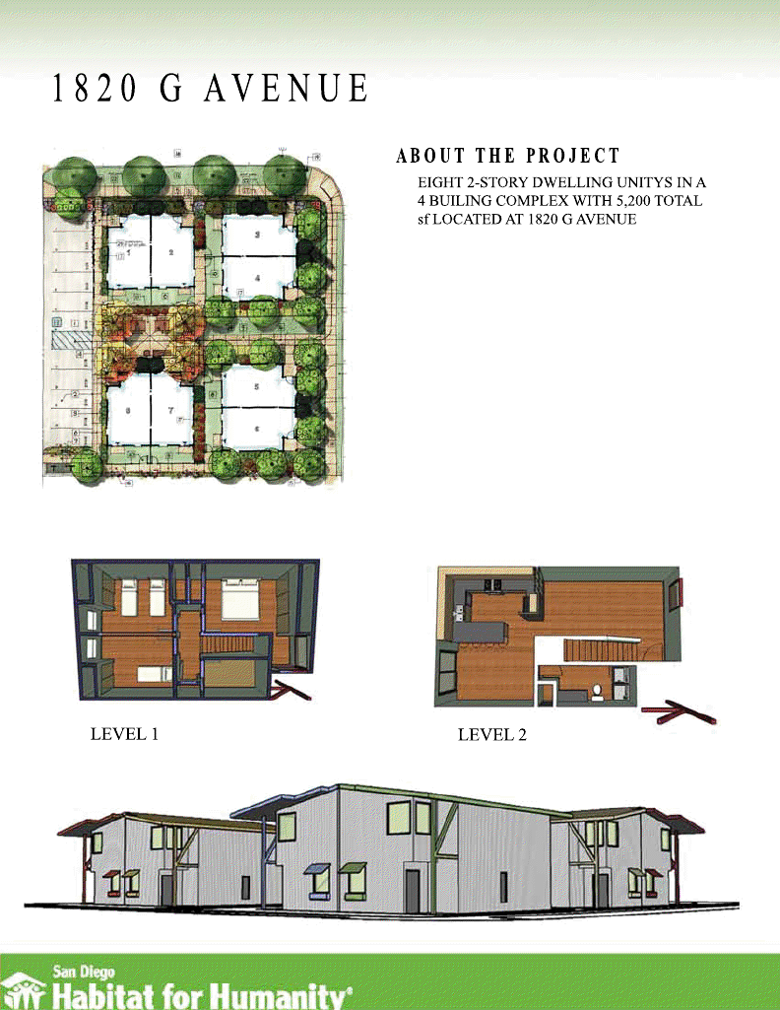
Building Opportunities
Working with San Diego Habitat for Humanity Affiliate
Our build days will be Tuesday, Wednesday, and Friday
We will be building at a location called G Avenue. We will be building townhomes!
On Thursday, we will be working at the ReStore facility

Slide 5
Exploring San Diego
On Monday, we will spend our day off at the San Diego Zoo
During the week, we will have the chance to visit the following:
Seaport Village
Coronado

